Slide 1
Driving Viral Hepatitis Elimination
through
Public Policy and Public Health
Prof Jeffrey V. Lazarus [Jeffrey.Lazarus@regionh.dk]
Editor-in-Chief, Hepatology, Medicine and Policy
CHIP, Rigshospitalet, University of Copenhagen, WHO Collaborating Centre on HIV and Viral Hepatitis
Affiliated researcher, ISGlobal, University of Barcelona
Hepatology, Medicine and Policy

Slide 2
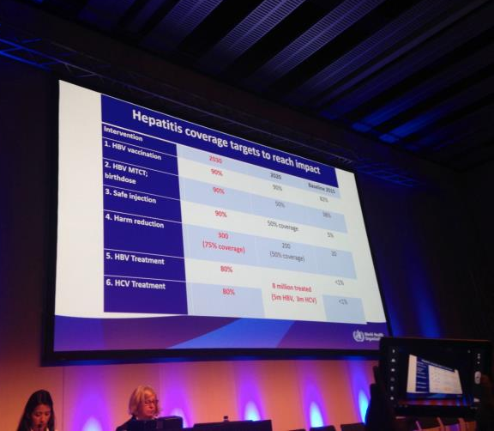
The Policy Landscape …
2016
2010
First World Health Assembly resolution on viral hepatitis
2010
2014
2015
2012
First WHO strategic framework on viral hepatitis
2014
Second World Health Assembly resolution on viral hepatitis
2015
Viral hepatitis named in Sustainable Development Goals
2016
WHO global health sector strategy on viral hepatitis
Notes:
~ First viral hep resolution – briefly
~ WHO viral hepatitis framework – mention that it was published and served as an interim strategic guidance document – don’t spend more time on it
~ Second viral hepatitis resolution – briefly
~ SDGs –
Goal 3.3 – By 2030, end the epidemics of AIDS, tuberculosis, malaria and neglected tropical diseases and combat hepatitis, water-borne diseases and other communicable diseases.
Goal 3.8 – Achieve universal health coverage, including financial risk protection, access to quality essential health-care services and access to safe, effective, quality and affordable essential medicines and vaccines for all.
~ WHO Draft Global Health Sector Strategy on Viral Hepatitis, 2016–2021 – ”the first of its kind”
~ After WHO draft strategy also mention forthcoming European Action Plan

Slide 3
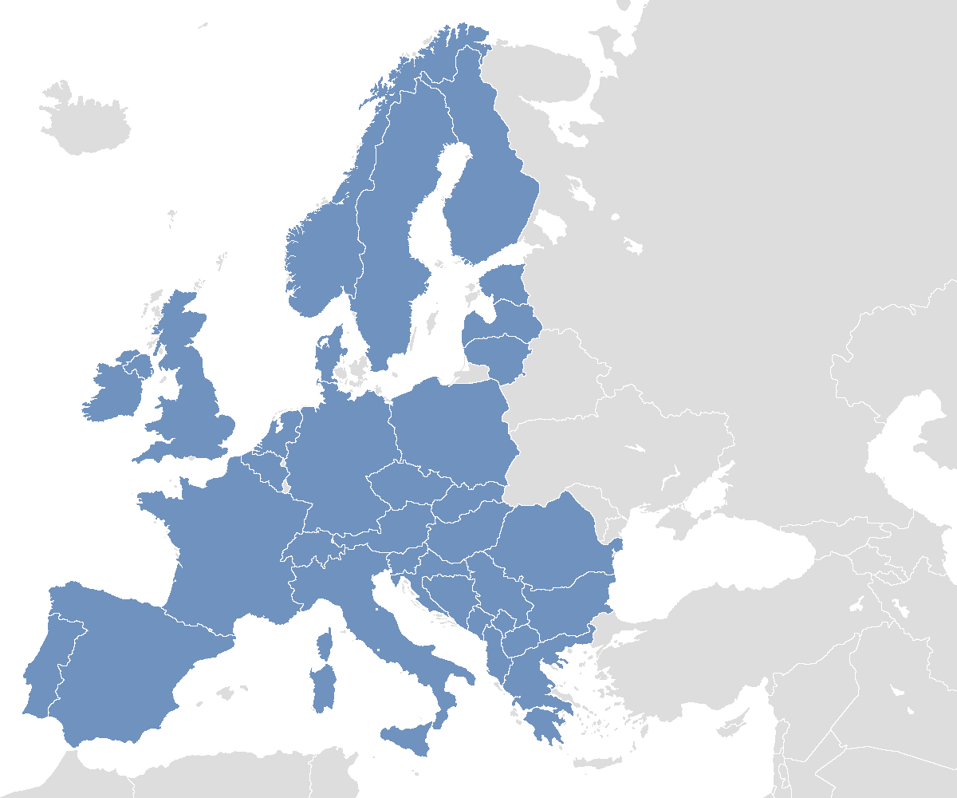
A survey of 33 European countries
National level activities on HCV management
National strategy, 12 (10 PWID) National action plan, 10 (7 PWID) National treatment guidelines, 24 (20 PWID)
iy
i
i
i
i
i
i
i
y
y
i
N
*Scotland was treated separately from UK
Maticic M et al. BMC Infect Dis 2014; 14(Suppl 6): 514-23.
Notes:
In 2014 a study was performed in 33 European countries on the existance of the national strategies, action plans and clinical guidelines for the management of HCV in PWID, that include testing as well as treatment.
[Point of this slide is long way to go even to get national strategies and plans in place.]

Slide 4
Monitoring the response – interim measures
WHO country intelligence reports
Hep-CORE

Slide 5
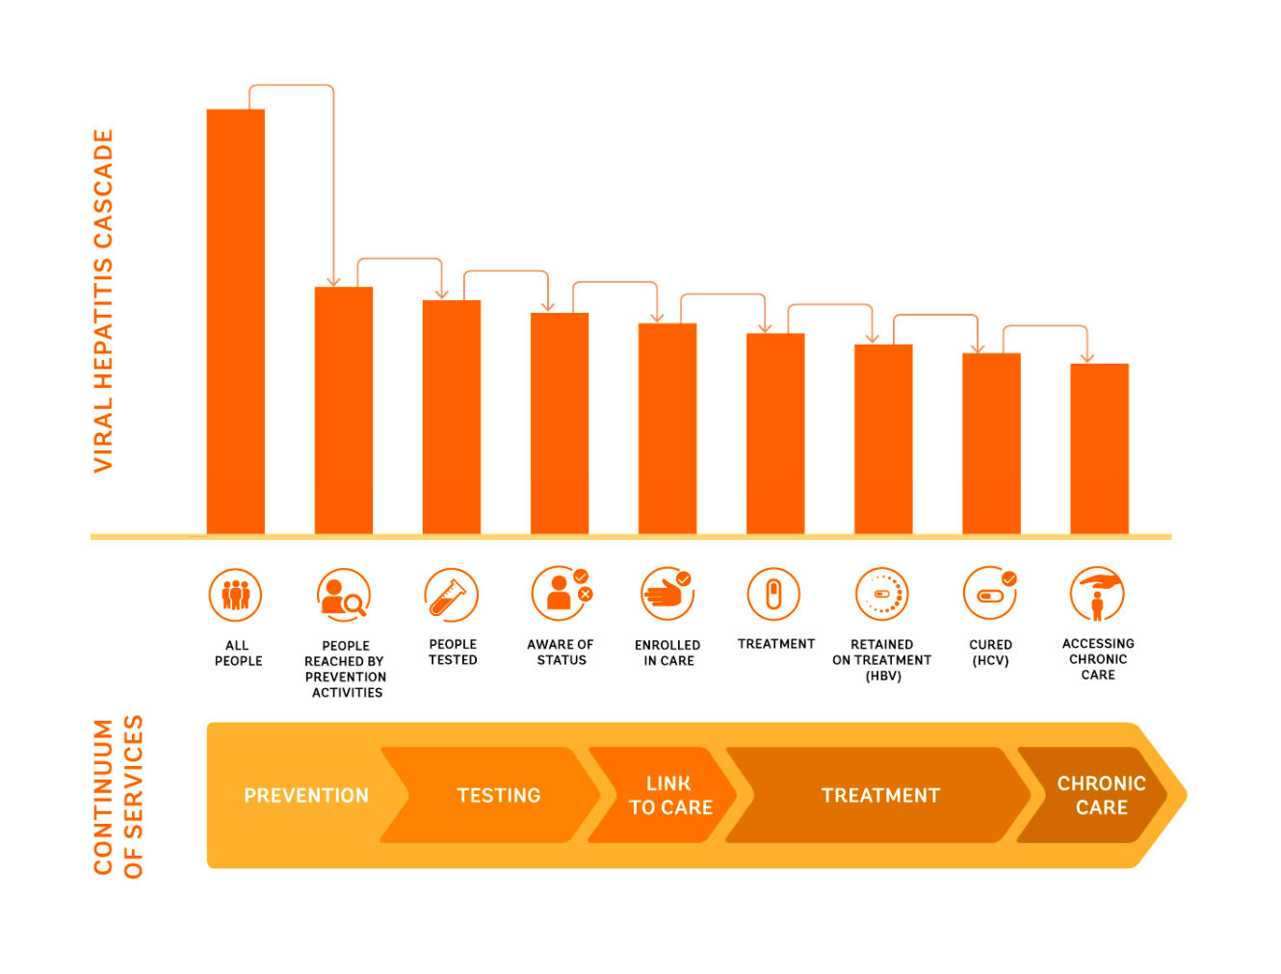
Implementing the WHO Strategy – what will it take?
Notes:
This slide will serve as a springboard for discussion of the myriad public health issues that need to be addressed in the course of implementing the WHO strategy.
We can either start by naming the issues, e.g. testing and diagnosis; linkage to care; harm reduction, stigma … or we can start by discussing country examples, and pulling the issues from those examples – e.g., highlighting the Georgian experience would lead to harm reduction among other issues.
Country examples to reference in this part of the discussion: Georgia Australia, Spain, Scotland, Portugal, Iceland, Denmark, Finland
Talking points about Georgia – even with strong NSPs, PWID are at risk of not being linked to treatment opportunities//////JEFF TO CONFIRM – also “NSP disconnect” – 35,000 PWID?/////
Talking points about ILC –
1. Although the abstract-driven sessions included some interesting public health research, the biggest public health news at the ILC came from other events.
2. First time the ILC programme included a major policy session.
3. WHO introduced its updated clinical guidelines. Good-sized audience, and when it was announced that the printed booklets had arrived in the back, people made a mad dash...
4. WHO also discussed its forthcoming viral hepatitis testing guidelines at another session. Researchers who had contributed evidence during the guideline deliberation process shared their insights about some issues that we can expect to see addressed much more as efforts to scale up testing intensify – (a) role of POC and DBS testing (b) cost of testing (c) need to improve linkage to care.
5. Discussions about the concept of spending now to save later – mounting economic evidence; need to take that evidence to national governments
Talking points about Egypt –
1. Role of leadership and political commitment
2. Widespread awareness in the population
3. Gilead’s willingness to expedite the use of generics
4. Just because a national government wants to scale up, this doesn’t mean it has the capacity – or the absorptive capacity – to do so.
Talking points about advocacy and engagement –
1. Everyone needs to be involved, including clinicians – specify what we want them to do in concrete terms

